Slide 1
Data Driven Decisions
Elizabeth Wojcik Director of Client Strategy & Development Computer System Innovations
Notes:
Good afternoon! We are going to talk about data! Get excited!

Slide 2
Session Overview
Common data pitfalls
Best practices to overcome those pitfalls
Putting your data to work
Q&A
Notes:
Data is powerful and by using it you can better support your work and achieve more successful outcomes. Whether its, sending targeted communications to donors based on interaction trends or choosing the right messaging based on the donors response activity.
We will start at the beginning with understanding your data, where we see common issues or pitfalls surrounding data and data management practices.
We will talk about ways to improve how you use and view your data and ultimately how to make your rich data work for your benefit.
I want this to be interactive so please ask questions, share examples and offer thoughts for those in the room to learn. One area we cannot compete in is data management and best practices. The better we can share and collaborate, the more we strengthen our organizational missions.

Slide 3
Discussing Data ‘Pitfalls’
Notes:
Before we talk about how to use your data to drive decisions, let’s first talk about some common issues that we see within organizations and their data.

Slide 4
Common Data Pitfalls
Not capturing what you need
Missing the end goal
Poor utilization of resources
Siloed data in systems without integration
Inconsistent staff procedures/practices
Not adapting to change
Death by “notes”
Notes:
So, what are some data pitfalls?
In my opinion, the most important issue is missing the end goal. What does that mean? It doesn’t mean not meeting your goal fundraising amount or response rate, it means missing the potential of how data can help you meet the overall goal and help you in decision making during the process and in the future. If we are not tracking data effectively, it will be more difficult to show the effectiveness of the project or campaign. Other pitfalls include poor utilization of resources meaning involvement of your technology teams and technology resources available to you. The typical process is that we bring technology in at the end of the project and by that point, it is too late and we are only able to apply “band aid” solutions.
Another pitfall is siloed data in external systems where that data is not getting back to your database. When you don’t have all your data in one place, you cannot effectively manage the project and get a clear picture about how you are doing.
Many of us are at organizations where we have staff that have been working there for many, many years and with that tends to be a problem with consistent processes. Because we know Suzie created the gift entry process back in 2008 and it has not changed even though you have gone through many changes since then with system upgrades and goal changes. We need to make sure we are updating procedures to make sure processes are consistent. If they are not consistent, that means our data will not be consistent and therefore basically useless to us. We need to also get out of the “this is the way we have always done it” model and make sure we adapt to change in systems and goals and always make sure we are getting that data in efficiently. Your staff has better things to do than to spend all day on data entry.
Finally, we all have run into the “death by notes” issue meaning we have notes all over the place but can’t analyze any of it. Most of it is in someone’s email or just their brain where we can’t retrieve it.
So, we’ll talk about some tactics during this session to overcome these pitfalls.

Slide 5
What data are you collecting?
Demographic info
Family/Parent
Education/Career
Donation Data
Volunteer History
Wealth Data
Cultivation Activities
Proposal Documents
Notes:
Let’s share what data your organization currently collects. Can I get some examples?
How much do you show to the actual member?
Do you reach out to influence members to update their info?
Do you plan projects to use 3rd party resources to help you collect data?

Slide 6
What’s the end goal?
# of gifts
$ raised
% Donor retention
# recurring gifts
Year to Year comparison of data
Will results be published?
Does your team need the ability to view live stats as areas/projects progress?
Notes:
One of the first steps we should always complete before starting a project or campaign is to make sure we know the end goal. Now, this is more of that tactical side of your goal but leads you back to your overall goal. You should ask yourself some of these questions as they will identify how the data needs to be tracked so that you can show results. For example, if you want to know how many gifts came in online vs mail vs phone call, then you need to make sure you have coding such as appeal code or a source code to identify the method of entry and then you can show those results.
It is also very important you establish these data points and parameters on the front end as you want to show consistent data to your project team rather than changing your formulas and processes midstream.
Go ahead and map out what data needs to be viewable as the project continues so you can work with your technology team to establish dashboards and reports that show them progress.

Slide 7
IT/Resource involvement
Include IT during initial project conversations
Share the overall goal so they can understand the full picture
Confirm the capabilities of your system and what may need to be configured
Collaborate on data tracking methods and output needs
Work with vendor resources to gather input on best practices
Do you have a database champion in your department?
Notes:
Ok, we wouldn’t be doing our job if we didn’t stress the importance of involving your technology resources. Let’s talk about why this is important.
When you bring in IT early into the conversations about the project, they can assist by identifying current functionality of systems and where configuration may be needed.
But backing up a step, make sure you are bringing IT into the full picture. The common problem is that IT assistance is only requested for specific areas that are seen as technology focused. When we don’t give them the full picture and overall goal, we limit ourselves to not identifying areas where IT can assist that we didn’t think about. You may be spinning your wheels creating reports and sending them via email where IT could help produce online reports and dashboards that can be accessed at any time and show real time data.
So, you should include them in conversations and project plans so that they can provide you with long term solutions that may be useful for future projects. Remember, no more “band aid” solutions. They are a waste of valuable time and dollars.
Lastly, while we want to involve the IT department in our projects, we also want to be as self sufficient as possible. You should be investing in a resource within your department to learn from IT and work with them to better understand system capabilities. When you have a resource within your area with greater technical knowledge, you benefit from this additional knowledge in conjunction with better understanding of how the department works and their preferences.

Slide 8
Unlocking your data
Where do you have valuable data?
Spreadsheets
Email marketing tools
Online donation platforms
Survey tools (Survey Monkey)
Form builders (Wufoo, Google Forms)
Can you easily get it out of one system/area to your database?
If not…
Create a plan
Prioritize the data
Integrate where it makes sense
Notes:
So something I see from time to time is individuals or organizations getting stuck with wanting to report and analyze data but not knowing where. We talked about siloed systems before and we all know we have them. Start with identifying where you have your data and can you easily retrieve it? If there is not an easy way to store the data in a centralized location like your database then we should explore opportunities for integration.

Slide 9
Process Documentation
Make sure to have documented procedures that are reviewed annually
Cross train staff on procedures to reduce errors during transition
Work with your database vendor to confirm core system procedures vs custom procedures
Include control when possible, i.e. dropdown fields, defined data types, etc.
Notes:
As you recall, we talked about a data pitfall of inconsistent process documentation. How do we prevent this? Here are a few recommendations.
Review processes with staff to make sure we are completing things in the most efficient way. This is also a great opportunity to cross train staff to support during staff transition and sometimes when you have more people understand the process, they can collaborate on how to improve the process going forward.
While reviewing those procedures, make sure you are referencing system documentation as many steps are standard procedure for your system. This is also a great time to bring in your database solution provider to see if there are any updates to best practices or new features within upgraded versions.
Finally, as you review those processes, make sure to identify ways you can involve more control. For example, could some of your fields be dropdown fields where we can prevent misspelling or “new” options that staff/volunteers may decide to use.

Slide 10
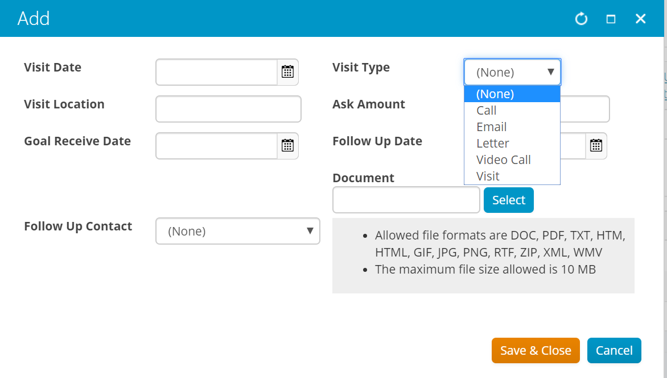
Moving Beyond ‘Notes’
Collect what you can analyze
Date
Type of contact
Amount asked
Proposal document
Next steps
Follow up date
Follow up contact
Additional comments
Notes:
We talked about Death by Notes earlier so let’s give an example of that issue. What we don’t want to see is not enough detail or usable data in you note. Is it all text? That make is very hard to analyze!
So, let’s make a better note. Here are some example data points that are easy to analyze and give us good insight into our progress.

Slide 11
Displaying Data
Donor Profile
Data sharing with Fraternity/Foundation/Housing
Mobile Friendly
Give volunteers access
Stop the email madness!
Dashboards
Year to Year comparisons
Stats by Campaign/Distribution/Appeal
Task List (follow up dates for asks)
Notes:
Once we have our data in a consistent and usable way, we need to make sure we can share this data with those that need it.
The first step is making sure you have a complete profile on your members. We want to make sure we are not duplicating data that is collected on the Fraternity side. The Foundation should have input on what is collected on a member’s profile so you can get basic information on that member to prepare for visits.
Many of your staff and volunteers are on the road making these contacts, so this data should be presented to them in a mobile friendly environment. Save those trees and view information on your phone or iPad!
With more systems having better reporting features, it should be possible for you to allow non-staff members access to information in a secure way. So, if they are on your volunteer cultivation team, you should be able to give them access during their service to the data that they need to make a successful interaction. I know we are so used to email but the second you send that email with data, the data is instantly old and obsolete.
The best way to share data in a quick way is through dashboards. You can breakdown key elements that identify success. Keep in mind that Dashboards should show real time data but also be fluid in that you should analyze the data points you are looking at to see if it is helping you make decisions.

Slide 12
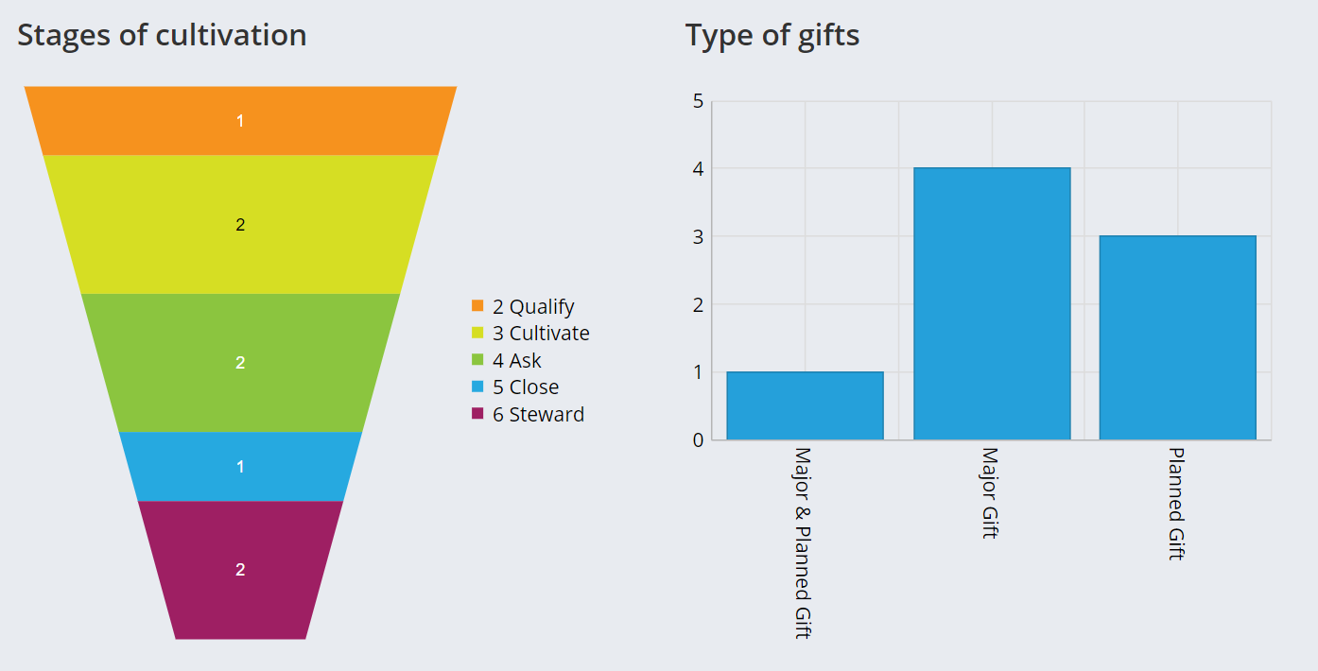
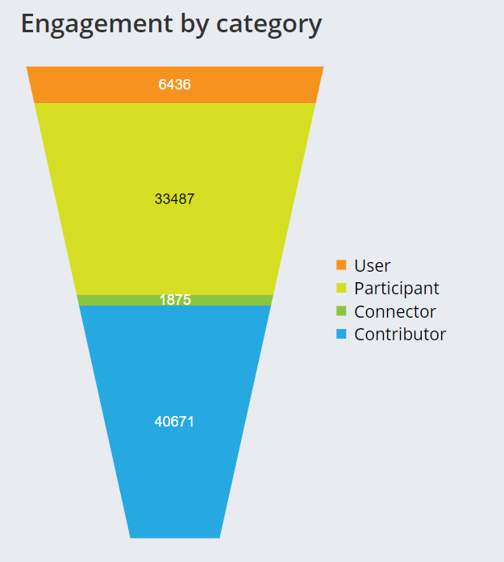
Displaying Data
Notes:
Dashboards aren’t only for membership and fundraising data. Think about the things that help in a communications and marketing world. What might make you change your email timing, content, etc. But remember, these types of dashboards are only possible if you data is brought back into your database.

Slide 13
Putting Your Data to Work
Notes:
What can you learn from your data to further your fundraising efforts? What can it tell you about the tools you use and your stewardship efforts.

Slide 14
What can your data tell you?
Donor retention
Donor preferences
Inform your stewardship
Appeal ROI
Mobile vs. Mail
Website/profile tools
Developing personas
Notes:
Donor retention – most one time donors when asked say they don’t repeat because they were not recognized appropriately
Appeal ROI – are you tracking your appeal cost and dollars raised to make sure that they are following reasonable cost guidelines for solicitation?
With the right data, you can compare to trends in the industry. In order to get the most of using big data, you have to have a good set of data about your members.

Slide 15
One data point can make a difference...
Happy birthday/initiation anniversary emails as cultivation / stewardship
Milestones can be important for donor development
Targeting donors for planned giving
Charitable IRA rollover for those approaching 70.5
Notes:
Connect with members to remind them of their affinity to the organization.
Milestones can be important for donor development
Targeting donors for planned giving – knowing donors approaching 65
Charitable IRA rollover for those approaching 70.5

Slide 16
Online Giving Trends
When direct mail donors begin giving online their giving increases 35-50%
Donors who use more than one channel for giving have 2x the retention rate in that year
Notes:
Recent studies have shown that....
How does your data compare? How can you take this knowledge to create appeals to create repeat donors or upgrade donors to a higher giving level.
Again, do you have these statistics with your own data to be able to compare?

Slide 17
Technology usage
Notes:
Are you gathering stats from your websites and online giving tools to identify their habits? These are some very basic stats but can help you in optimizing your tools and creating the best donor experience.
You may find that the bulk of your donors are interacting with you via a cell phone or tablet and mobile responsive is not enough but you need to be thinking "mobile first"

Slide 18
Developing Personas
Identify your different audiences to drive your communications and messaging.
Who, What, Why, and How
Who are your members, volunteers, donors, prospective members, other important constituents?
What do you know about them?
Why do they respond, act, feel the way they do?
How do you need to adjust to increase engagement and/or affinity?
Notes:
Personas are a great way to identify your audiences to more clearly market to those that might be interested. This can help you drive your messaging methods. Ask the who, what, why and how.
To use personas, you will mesh the data that you already have with data you collect from members. You have data such as membership milestones, giving details and their involvement with the organization. The data you need is what you can’t find in demographics. Identify who you need data from and start an interview/survey process. There is not a magic number on how much data you need but you will know once you start seeing results come in. The questions should be phrased as “why” questions, why do they volunteer? Why do they give? Why did they join?
With the data, you could give personas a name. We have some examples here and they may be silly but they identify the group you are referring to based on the data you know about them.
You then want to include the demographics and background of these members along with how they identify with your organization.
You especially want information on how they prefer to be communicated with and how they interact with the organization online.
As an organization, you can identify what are your goals and challenges for working with this persona.
While we may have persona data, if we don’t use it well, they will fail. We don’t use the data to our advantage as we don’t have full buy in to the logic.
We recommend using personas to segment your communication. Here are some examples.

Slide 19
Bringing it all together
You don’t know what you don’t know…
Identify those things and create a plan
Use the data to your advantage
No matter where you are today, always keep evolving
Notes:
Let’s bring it all together. You don’t know what you don’t know. Identify those areas and analyze the data.
Always continue to look for areas to improve on!

Slide 20
Q&A
Elizabeth Wojcik ewojcik@csiinc.com
Computer System Innovations
www.csiinc.com
Notes:
Let’s discuss!
What data are you missing?
What information is important to have on donor visits?
What data to you provide your volunteers?

